Slide 1
Ticketing data analysis for Performance Evaluation Case Study: Route SBS 1k , BMTC
September, 2019

Slide 2
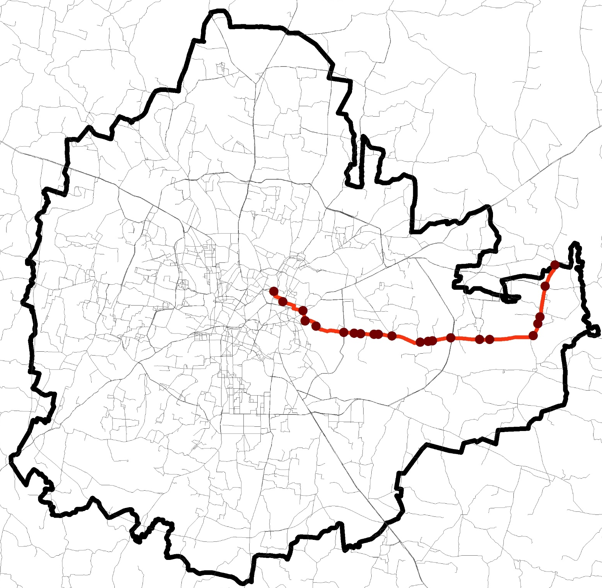
Route details
Bangalore
SBS1K
BMTC Bus route map
Route Length: 23km
Approx. travel time : 1hr 14min
Kadugodi Bus
Station
3 Depots -17 schedules
Schedule type | Number of schedules | No. of trips | Depot
Sub-urban Day Out | 10 | 128 (65%) | 6, 41
Sub-urban Night Out | 4 | 43 (22%) | 6
Sub-urban General Shift | 3 | 26 (13%) | 6, 16
Total | 17 | 197 | 3
Shivajinagara Bus Station
Depot 16
Depot 6
Depot 41
112 trips scheduled from Shivajinagara Bus station to Kadugodi Bus station,
Other 85 trips are cut trips and depot trips

Slide 3
Data Analysis
ETM data observed for December 2018, route SBS-1K
Total 3204 trips recorded for 30 days
Only whole route trips data available(i.e. from Shivajinagara Bus station to Kadugodi Bus station); cut trips data are absent
Only 2585 trips used for analysis, with rest trips having error in data records, or empty trips with time duration of few minutes.
 | Trips | Up direction | Down Direction
Total Trips | 3204 | 1584 | 1620
Trips used | 2585 (80%) | 1214 | 1371
Empty trips | 375 (13%) | 216 | 158
Error in records | 207 (07%) | 135 | 72

Slide 4
Service Delivery
1

Slide 5
Service Delivery
1
Actual trips
Planned Trips
v/s
112
(56 each dir)
85 (+/- 5)
42 each dir (+/-3)
*only full length trips
Buses scheduled per day v/s buses operated per day
17 buses scheduled
21 buses operated (average)
Planned Vs Actual
27% shortfall in trips undertaken Vs planned
Majority trips made in off-peak hours (3-5 PM)
Evening peak (6-9 PM) has the maximum shortfall in trips
Number of trips undertaken per bus vary from 1 to 7
Notes:
% variation in text box
Maybe on top
Why is this difference present

Slide 6
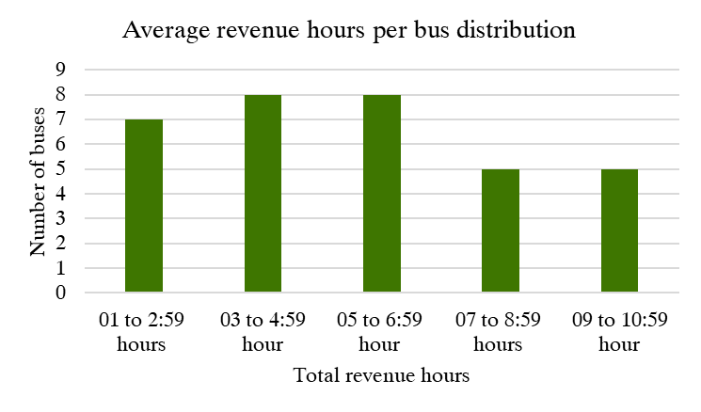
Service Delivery
2
Average revenue hours per bus
5 hours, 38 minutes
As against
Per bus calculations
Scheduled 15 hours per day
Number of buses operated are more than scheduled
Leading to approximately 56% less revenue hours per bus
Only 5 buses of 21, operate for 9 to 11 hours per day

Slide 7
Service Delivery
3
Average buses per hour
1
Inconsistency in bus dispatch from depots
2
Inconsistency in peak hour schedules
From Kadugodi Bus Station
(Down Direction)
3
Unavailability of buses during peak hours
Buses per hour |  | 05 | 06 | 07 | 08 | 09 | 10 | 11 | 12 | 13 | 14 | 15 | 16 | 17 | 18 | 19 | 20 | 21 | 22
03-12-2018 | Monday | 0 | 4 | 3 | 5 | 1 | 2 | 3 | 2 | 1 | 3 | 4 | 4 | 1 | 2 | 0 | 0 | 2 | 0
04-12-2018 | Tuesday | 0 | 3 | 5 | 4 | 1 | 4 | 3 | 4 | 3 | 3 | 4 | 3 | 3 | 1 | 0 | 0 | 0 | 0
05-12-2018 | Wednesday | 0 | 2 | 5 | 4 | 2 | 1 | 3 | 6 | 1 | 3 | 5 | 4 | 0 | 2 | 1 | 1 | 0 | 0
06-12-2018 | Thursday | 0 | 2 | 3 | 6 | 2 | 5 | 2 | 5 | 2 | 0 | 4 | 4 | 3 | 0 | 1 | 2 | 1 | 0
07-12-2018 | Friday | 0 | 6 | 4 | 4 | 3 | 2 | 4 | 4 | 0 | 2 | 7 | 2 | 1 | 1 | 3 | 0 | 1 | 0
10-12-2018 | Monday | 1 | 5 | 4 | 3 | 2 | 4 | 2 | 3 | 3 | 3 | 3 | 5 | 3 | 1 | 0 | 0 | 1 | 0
11-12-2018 | Tuesday | 1 | 4 | 5 | 3 | 3 | 2 | 6 | 2 | 3 | 4 | 3 | 3 | 3 | 1 | 1 | 0 | 0 | 0
12-12-2018 | Wednesday | 0 | 4 | 3 | 7 | 2 | 2 | 4 | 3 | 0 | 4 | 3 | 4 | 1 | 3 | 0 | 1 | 1 | 0
13-12-2018 | Thursday | 1 | 5 | 3 | 4 | 2 | 3 | 3 | 3 | 3 | 2 | 6 | 2 | 2 | 1 | 0 | 3 | 0 | 0
14-12-2018 | Friday | 0 | 5 | 2 | 6 | 3 | 2 | 2 | 5 | 1 | 3 | 3 | 4 | 2 | 0 | 2 | 2 | 0 | 0
17-12-2018 | Monday | 0 | 5 | 6 | 1 | 4 | 3 | 2 | 3 | 2 | 3 | 2 | 3 | 2 | 1 | 1 | 2 | 0 | 0
18-12-2018 | Tuesday | 1 | 3 | 4 | 3 | 5 | 2 | 2 | 5 | 3 | 3 | 5 | 3 | 3 | 1 | 1 | 1 | 0 | 0
19-12-2018 | Wednesday | 0 | 4 | 4 | 5 | 3 | 0 | 4 | 2 | 3 | 1 | 7 | 1 | 3 | 2 | 1 | 2 | 1 | 0
20-12-2018 | Thursday | 1 | 3 | 4 | 7 | 2 | 3 | 3 | 4 | 2 | 1 | 3 | 5 | 2 | 1 | 1 | 2 | 0 | 0
21-12-2018 | Friday | 1 | 5 | 2 | 4 | 2 | 4 | 2 | 4 | 2 | 3 | 5 | 3 | 2 | 0 | 2 | 2 | 0 | 0
24-12-2018 | Monday | 1 | 4 | 6 | 4 | 1 | 6 | 1 | 3 | 1 | 2 | 5 | 3 | 2 | 1 | 1 | 0 | 2 | 0
26-12-2018 | Wednesday | 1 | 4 | 4 | 6 | 2 | 3 | 4 | 3 | 0 | 3 | 9 | 0 | 2 | 2 | 1 | 0 | 1 | 0
27-12-2018 | Thursday | 1 | 2 | 7 | 5 | 1 | 5 | 3 | 4 | 0 | 3 | 4 | 4 | 2 | 1 | 0 | 2 | 1 | 0
28-12-2018 | Friday | 1 | 3 | 4 | 5 | 3 | 4 | 3 | 3 | 2 | 4 | 5 | 2 | 4 | 0 | 1 | 0 | 1 | 0
31-12-2018 | Monday | 1 | 3 | 5 | 5 | 3 | 4 | 3 | 2 | 3 | 0 | 4 | 4 | 3 | 2 | 0 | 1 | 0 | 1
7 Buses
3 Buses
Buses per hour
2 Buses
Significant variation in service delivery across days
Inconsistency in peak hour service delivery across days
Significant drop in evening peak service delivery
6 Buses
13 Buses
6 Buses

Slide 8
Service Delivery
3
Average buses per hour
1
Inconsistency in peak hour schedule
Shivajinagara Bus Station (Up Direction)
2
Unavailability of buses during peak hours
Buses per hour |  | 05 | 06 | 07 | 08 | 09 | 10 | 11 | 12 | 13 | 14 | 15 | 16 | 17 | 18 | 19 | 20 | 21 | 22
03-12-2018 | Monday | 0 | 4 | 4 | 2 | 1 | 5 | 3 | 1 | 3 | 3 | 6 | 2 | 0 | 0 | 3 | 2 | 0 | 0
04-12-2018 | Tuesday | 0 | 4 | 3 | 5 | 0 | 3 | 4 | 2 | 3 | 4 | 5 | 2 | 0 | 0 | 4 | 1 | 1 | 0
05-12-2018 | Wednesday | 0 | 3 | 4 | 5 | 1 | 3 | 3 | 3 | 2 | 6 | 3 | 2 | 2 | 0 | 1 | 3 | 0 | 0
06-12-2018 | Thursday | 0 | 5 | 4 | 3 | 2 | 3 | 4 | 1 | 1 | 6 | 3 | 0 | 1 | 1 | 2 | 1 | 2 | 1
07-12-2018 | Friday | 0 | 5 | 5 | 4 | 2 | 3 | 4 | 0 | 2 | 4 | 4 | 2 | 2 | 0 | 1 | 5 | 1 | 0
10-12-2018 | Monday | 0 | 4 | 3 | 5 | 0 | 4 | 3 | 2 | 1 | 6 | 4 | 2 | 0 | 0 | 4 | 2 | 0 | 1
11-12-2018 | Tuesday | 0 | 4 | 4 | 4 | 2 | 4 | 4 | 2 | 4 | 1 | 6 | 1 | 1 | 0 | 3 | 2 | 1 | 0
12-12-2018 | Wednesday | 0 | 3 | 6 | 5 | 0 | 4 | 6 | 1 | 1 | 4 | 5 | 2 | 0 | 1 | 1 | 3 | 1 | 1
13-12-2018 | Thursday | 0 | 4 | 2 | 6 | 3 | 4 | 3 | 2 | 2 | 5 | 4 | 1 | 0 | 2 | 1 | 1 | 2 | 0
14-12-2018 | Friday | 0 | 3 | 6 | 3 | 1 | 6 | 4 | 0 | 1 | 6 | 4 | 2 | 1 | 1 | 0 | 4 | 3 | 0
17-12-2018 | Monday | 0 | 4 | 3 | 6 | 3 | 1 | 4 | 1 | 2 | 5 | 3 | 2 | 1 | 0 | 2 | 3 | 0 | 0
18-12-2018 | Tuesday | 0 | 2 | 6 | 4 | 1 | 4 | 4 | 2 | 3 | 4 | 4 | 3 | 1 | 0 | 2 | 2 | 2 | 0
19-12-2018 | Wednesday | 0 | 3 | 5 | 4 | 3 | 4 | 3 | 2 | 4 | 1 | 5 | 3 | 1 | 1 | 2 | 5 | 0 | 0
20-12-2018 | Thursday | 0 | 4 | 6 | 3 | 1 | 5 | 4 | 2 | 1 | 6 | 3 | 2 | 1 | 1 | 2 | 1 | 2 | 0
21-12-2018 | Friday | 0 | 5 | 3 | 4 | 1 | 3 | 3 | 2 | 1 | 7 | 3 | 2 | 1 | 1 | 1 | 4 | 2 | 1
24-12-2018 | Monday | 0 | 4 | 5 | 6 | 3 | 2 | 1 | 1 | 2 | 5 | 5 | 1 | 1 | 0 | 3 | 1 | 1 | 1
26-12-2018 | Wednesday | 0 | 4 | 4 | 4 | 4 | 3 | 1 | 1 | 4 | 4 | 3 | 1 | 3 | 0 | 4 | 2 | 0 | 1
27-12-2018 | Thursday | 0 | 4 | 3 | 7 | 2 | 3 | 2 | 0 | 1 | 7 | 3 | 1 | 0 | 3 | 2 | 0 | 2 | 0
28-12-2018 | Friday | 0 | 4 | 5 | 3 | 3 | 3 | 3 | 1 | 2 | 7 | 5 | 1 | 1 | 0 | 5 | 1 | 1 | 0
31-12-2018 | Monday | 0 | 3 | 5 | 5 | 3 | 4 | 1 | 1 | 1 | 5 | 4 | 2 | 1 | 0 | 1 | 3 | 2 | 0
8 Buses
Buses per hour
Significant variation in service delivery across days
Inconsistency in peak hour service delivery across days
Significant drop in evening peak service delivery
13 Buses
2 Buses
7 Buses

Slide 9
Ridership
1
Boardings per hour
Passengers boarded
Average boarding per day: 6129
Boarding per day per bus 268
Average boarding per trip (weekdays): 67
54% fewer trips in the evening hours compared to morning
High boarding in
the morning
Less boarding in
the evening
2
Passengers moved per hour per direction (PPHPD)
 | Morning Hours |  | Evening Hours
Direction | Passengers carried | PPHPD | Passengers carried | PPHPD
UP | 14953 | 299 | 5529 | 111
Down | 18596 | 371 | 9711 | 194
Total | 33549 | 670 | 15240 | 305
54% difference

